Slide 1
Custom View in Android (2)
Jaden Lin

Slide 2

Review of last Course
Introduction of View
Scenario of 3 types of custom view
Drawing procedure of View
Measure
Layout
Draw

Slide 3
Recap: Stack call and FlowChart of Measure
Perform
Traversal()
HasNext
Child View?
View
Group
onMeasure
Measure
Children
setMeasuredDimension
getRoot
MeasureSpec()
Measure
Child
Measure()
NextView:
View or ViewGroup?
Layout()
SetMeasuredDimension
onMeasure
View
View
Draw()
ViewGroup

Slide 4
Recap: Stack call and FlowChart of layout()
Perform
Traversal()
View
Group
layout
setFrame
onLayout
Measure()
HasNext
Child View?
End
getMeasured
Width/Height()
NextView:
View or ViewGroup?
Layout()
setFrame
Layout
View
View
Draw()
ViewGroup

Slide 5
Recap: Stack call and FlowChart of Draw
Perform
Traversal()
View
Group
draw
ondraw
dispatch
Draw
Measure()
HasNext
Child View?
End
getMeasured
Width/Height()
NextView:
View or ViewGroup?
Layout()
onDraw
draw
View
View
Draw()
ViewGroup

Slide 6
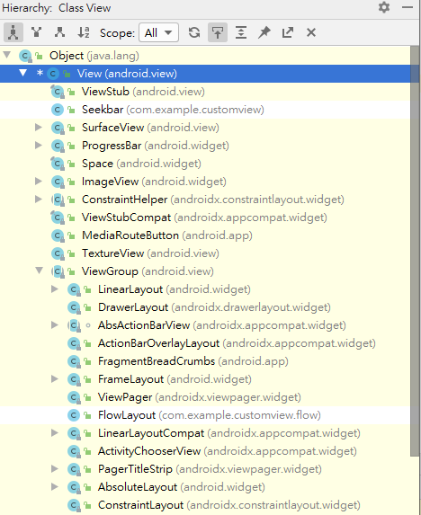
Introduction of View
View : a rectangular area on the screen and, responsible for drawing and event handling.
View is the base class for widgets (ImageView, Buttons, EditText).
ViewGroup: subclass of view, a special view that can contain other views (called children.)
ViewGroup is the base class for layouts and views containers.
Notes:
大家都知道， 你講的那麼官腔 這些我也知道，很簡單。
可是我還是要講

Slide 7
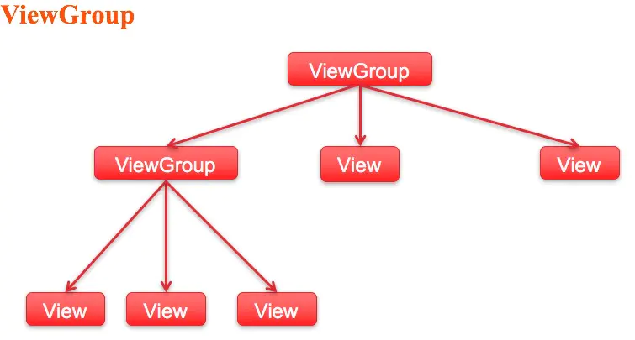
ViewGroup (Parent View)
Notes:
Viewgroup他有很多Children, 他相對於這些
所以ViewGroup 會包含View 也包含ViewGroup
有沒有人覺得很孰悉? 我們之後再來看一下

Slide 8
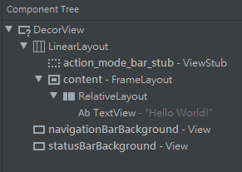
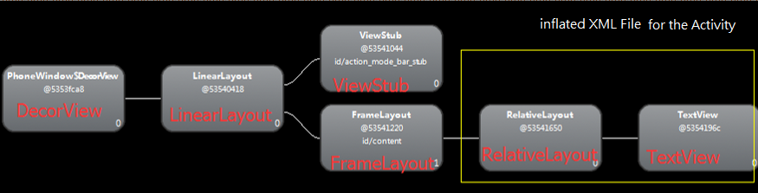
View in Activity
從Hierarchy (Component Tree)的角度來看:
Notes:
其他各位前輩有講過Layout Inspector，自己之前沒用過，我們新建一個簡單的project 打開來看一下好了。我們會看到甚麼? DecorView其實繼承自Framelayout,也是一個Viewgroup..在最上層 所以它是我們的root View

Slide 9
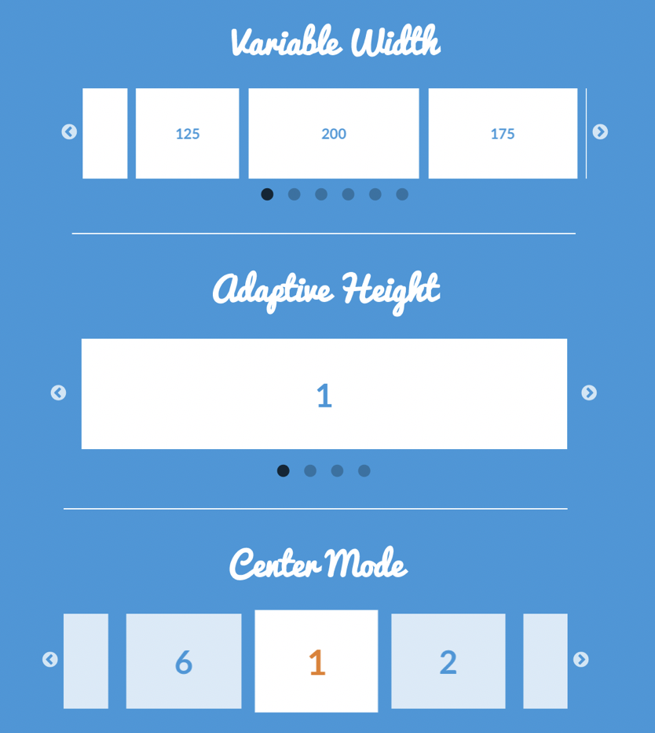

Compound Components (controls)
Compound Components
Custom
ViewGroup
Custom
View
Scenario:
Comprised of multiple existing components
Encapsulate these components into a single class

Slide 10

Custom ViewGroup
Compound Components
Custom
ViewGroup
Custom
View
Scenario:
Multiple Items, Dynamic Loading…..
There might be different number of items with different custom attributes.
We wish to lay our items in our own way based on these custom attributes.
Notes:
右邊這張圖 上傳照片

Slide 11
Custom View
Compound Components
Custom
ViewGroup
Custom
View
Scenario:
An atomic view that may need complicated drawing and animation
There might be customized attribute and touch event that may affect view’s style or graphics
Notes:
需要複雜的動畫和繪圖. 可能有一些動態的attribute去影響View的樣式和圖形

Slide 12
View的繪製流程
View
繪製流程
而我們的Custom View / ViewGroup就是override onMeasure(), onLayout(),onDraw()這三個方法.
這三個方法分別在measure(),layout(),draw()被呼叫
最複雜的就是Measure的過程, 既要測量View, 也要測量View Group
Measure
Layout
Draw
End

Slide 13
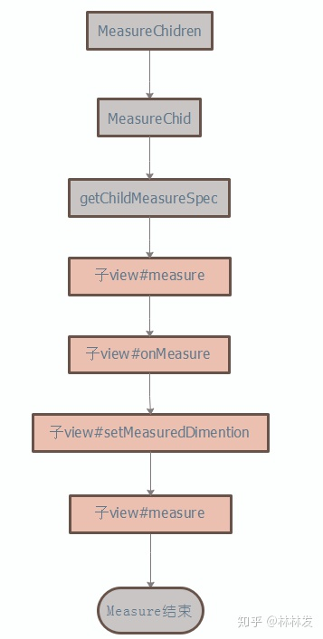

onMeasure()
View
繪製流程
Measure
onMeasure() receives the its own MeasureSpec calculated by and passed from its parent ViewGroup
Android自己定義的測量規格： MeasureSpec (包含Mode 跟Size)
Layout
Mode Size
Int MeasureSpec:
Draw
A MeasureSpec is comprised of a mode(2bits) and a size(30 bits) .
End

Slide 14
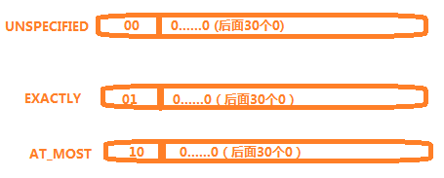
Mode of MeasureSpec
View
繪製流程
MeasureSpec其實是Parent ViewGroup 傳遞給Child view的佈局要求
3 types of modes:
Measure
未指定尺寸模式。父佈局沒有對子view強加任何限制。它可以是任意想要的尺寸。
Layout
精確值模式。父佈局決定了子view的準確尺寸。子view無論想設定多大的值，都將限定在那個邊界內。
Draw
最大值模式。子view可以一直大到指定的值。
End

Slide 15
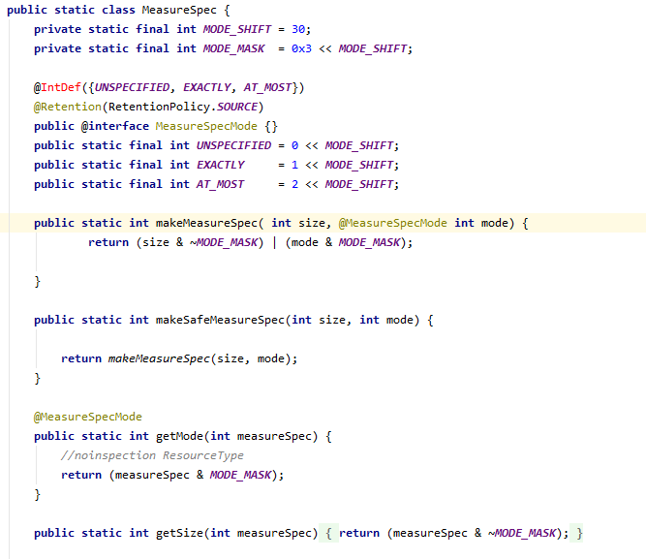
MeasureSpec
View
繪製流程
A Utility Class
Help us compose and
decompose the
MeasureSpec we use in
onMeasure()
The value of
MeasureSpec is still
an Integer
SpecMode
Measure
Layout
Draw
End

Slide 16
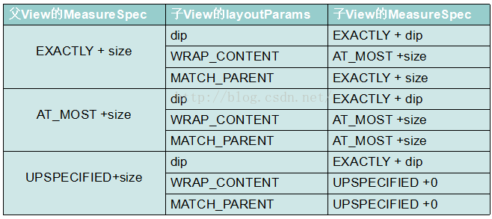
Purpose of MeasureSpec
Child View的大小受限於Parent ViewGroup的大小, Parent ViewGroup會將自己的限制傳遞下去
ParentViewGroup 根據自己的MeasureSpec和Child View的Layour Parameters 算出子View的MeasureSpec。

Slide 17
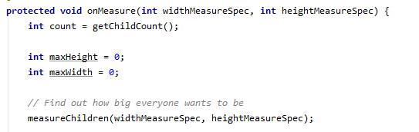
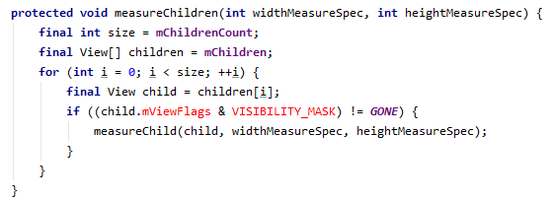
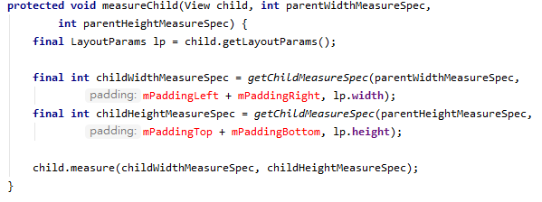
父View#OnMeasure
View
繪製流程
Measure
Layout
真正為Child View 算出MeasureSpec的地方!!!!
Draw
End
Notes:
好 講完剛剛那個例子做為一個工程師， 我們會希望會知道它具體的運作原理嘛!我們接著來看一下Measure 的Stack call

Slide 18
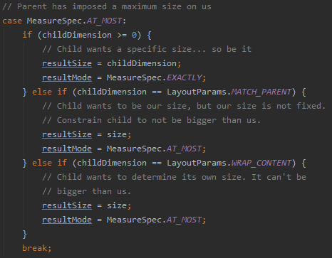
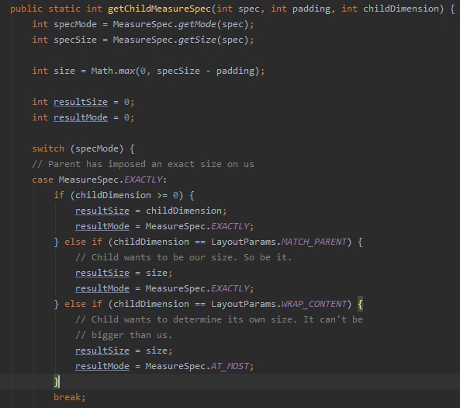
真正為Child 算出MeasureSpec的地方!

Slide 19
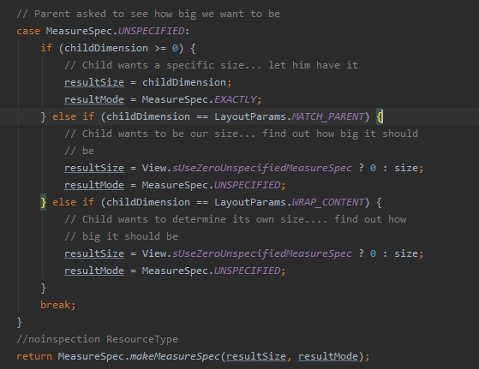

Slide 20

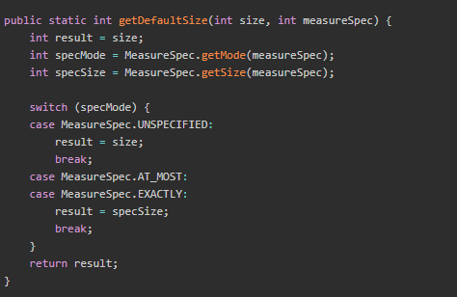
Child View set its own height and width by passing MeasureSpec Measured by Parent View
MeasureSpec of Child View
After ChildView gets its own MeasureSpec measured by ParentView, it calls OnMeasure().

Slide 21
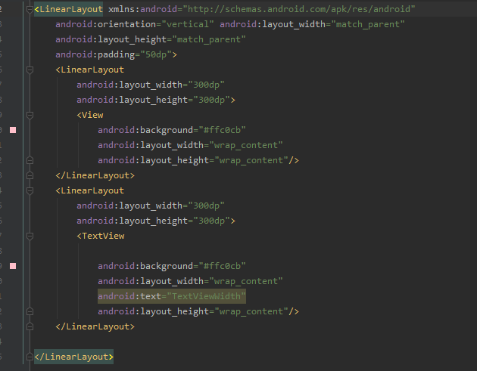
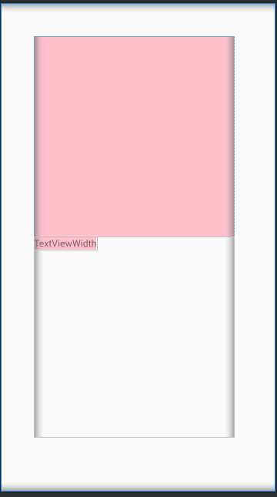
Child View set its own height and width by measureSpec measured by Parent View
Textview class overrides
onMeasure() method!!​

Slide 22
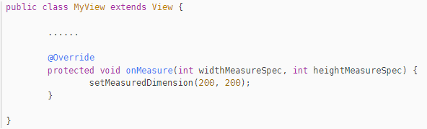
MeasureSpec calculated by Parent View is only a reference
View
Measure
The final width and height is set by calling setMeasuredDimension.
Layout
Draw
It’s OK to define whatever width and height you want!! If you did not call this function, an Exception will be thrown later.
End
Notes:
等下範例會講,客製化我們的Atmost

Slide 23
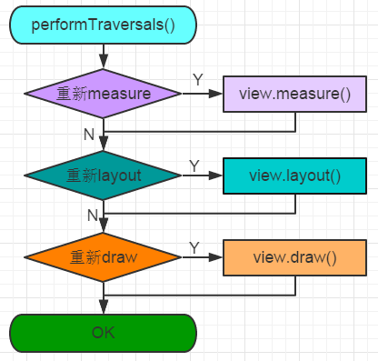
What is the Root View? How is its MeasureSpec is measured?
DecorView! performTraversals()!!
private void performTraversals() {
......
int childWidthMeasureSpec = getRootMeasureSpec(mWidth, lp.width);
int childHeightMeasureSpec = getRootMeasureSpec(mHeight, lp.height);
......
mView.measure(childWidthMeasureSpec, childHeightMeasureSpec);
......
mView.layout(0, 0, mView.getMeasuredWidth(),mView.getMeasuredHeight());
......
mView.draw(canvas);
......
}
Notes:
我們現在講了父親可以測量小孩了….. 那父親的父親是誰測量呢? 一直追溯上去?

Slide 24
Recap: Stack call and FlowChart of Measure
Perform
Traversal()
HasNext
Child View?
View
Group
onMeasure
Measure
Children
SetMeasuredDimension
getRoot
MeasureSpec()
Measure
Child
Measure()
NextView:
View or ViewGroup?
Layout()
SetMeasuredDimension
onMeasure
View
View
Draw()
ViewGroup

Slide 25
Step 2: Layout
View
繪製流程
Same as onMeasure. This method will be called from root view recursively!(DFS)
Measure
Layout
Draw
End

Slide 26
Layout() is called in performTraversal()
View
繪製流程
Same as onMeasure. This method will be called from root view recursively!(DFS)
Measure
private void performTraversals() {
......
int childWidthMeasureSpec = getRootMeasureSpec(mWidth, lp.width);
int childHeightMeasureSpec = getRootMeasureSpec(mHeight, lp.height);
......
mView.measure(childWidthMeasureSpec, childHeightMeasureSpec);
......
mView.layout(0, 0, mView.getMeasuredWidth(),mView.getMeasuredHeight());
......
mView.draw(canvas);
......
}
Layout
Draw
layout() method receives 4 parameters, and they represent left, top, right and bottom coordinate of the view respectively. All these coordinates are relative to its current Parent View.
End

Slide 27
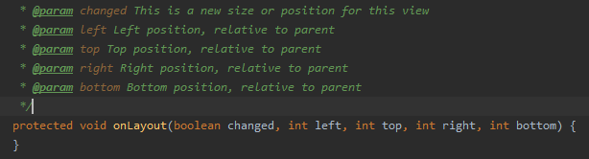

onLayout()
onLayout () method of View class is empty because it does not need to lay its children and View does not even have a child view.
View
繪製流程
Measure
Layout
How about onlayout() in ViewGroup.java?
Draw
onLayout() method of ViewGroup class is an abstract class., which means We must define our own way to lay children
End
Let’s take a look at how LinearLayout implements its way of layouts

Slide 28
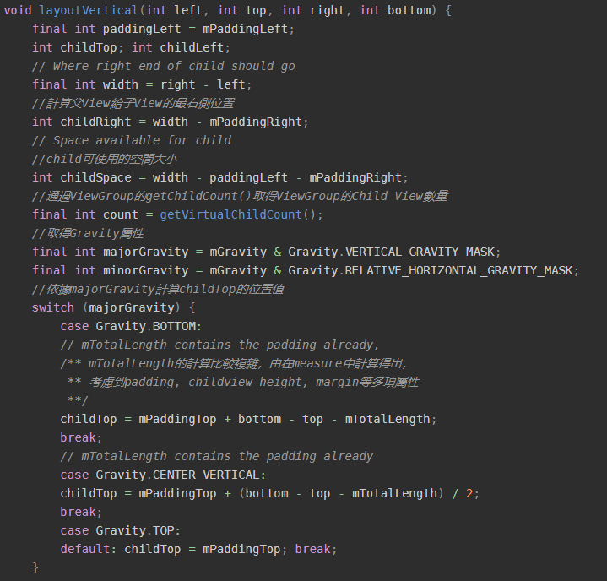
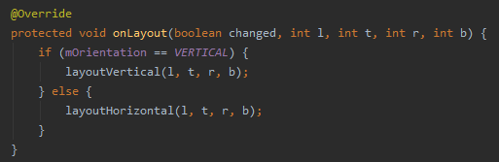
onLayout() in LinearLayout
View
繪製流程
Measure
大致上分為5步:
計算第一個Child 開始的Top座標
Iterate over all child views
通過Child View的measure後的寬高，margin和direction等attribute計算每一個Child相對於的上下左右 座標值
呼叫childView的layout() 設定他們的座標
通過margin,child高度累加child top值, 使其成為下一個View的起始座標
Layout
Draw
End
LinearLayout: https://android.googlesource.com/platform/frameworks/base/+/master/core/java/android/widget/LinearLayout.java

Slide 29
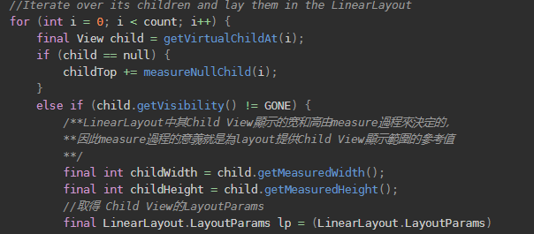
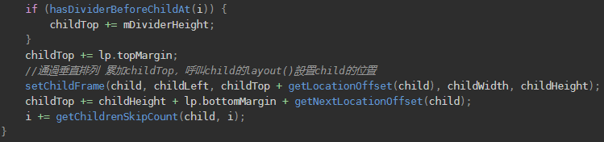
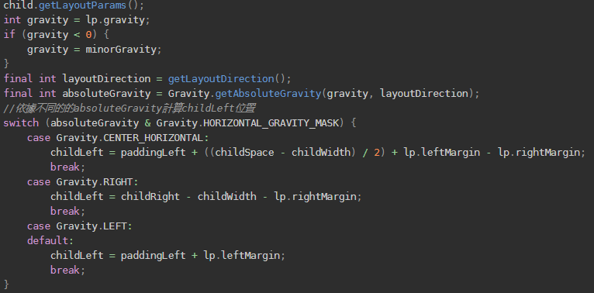

2nd step:
Iterate over Child Views
4th step: set child view coordinate
3th step:
Compute coordinates
5th step: update child top

Slide 30
Recap: Stack call and FlowChart of layout()
Perform
Traversal()
View
Group
layout
setFrame
onLayout
Measure()
HasNext
Child View?
End
getMeasured
Width/Height()
NextView:
View or ViewGroup?
Layout()
setFrame
Layout
View
View
Draw()
ViewGroup

Slide 31

Now, we know How layout of a ViewGroup works
View
繪製流程
Set in a certain place, (r,l,b,t), given by ParentViewGroup
Given measured height and width of each Child views,
We can Compute (r,l,b,t) for every Child Views
Once we have laid child views, the next step is to draw views
inside the rectangular area bounded by (r,l,b,t)
Measure
Layout
Draw
YES! onDraw is also executed in a same way.
End

Slide 32
Step 3: Draw
Measure() measures the height and width of a view, Layout() sets a view in a certain place on the screen, while onDraw() is the real place where the content of a view is drawed on the screen
View
繪製流程
Measure
Same as onMeasure and onLayout,
This method will be called from root view recursively!
Layout
Draw
End

Slide 33
What is the Root View? How is its MeasureSpec is measured?
DecorView! performTraversals()!!
private void performTraversals() {
......
int childWidthMeasureSpec = getRootMeasureSpec(mWidth, lp.width);
int childHeightMeasureSpec = getRootMeasureSpec(mHeight, lp.height);
......
mView.measure(childWidthMeasureSpec, childHeightMeasureSpec);
......
mView.layout(0, 0, mView.getMeasuredWidth(),mView.getMeasuredHeight());
......
mView.draw(canvas);
......
}
Notes:
我們現在講了父親可以測量小孩了….. 那父親的父親是誰測量呢? 一直追溯上去?

Slide 34
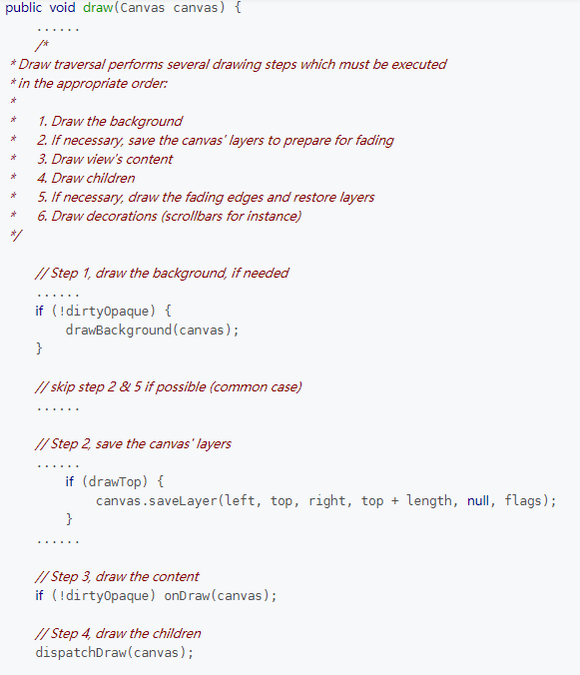
Steps of drawing
ViewGroup does not override draw(),
let’s take a look how View class implements this method
1. Draw the background : drawBackGround()
2. If necessary, save the canvas' layers to prepare for fading
3. Draw view's content : onDraw()
4. Draw children : dispatchDraw()
5. If necessary, draw the fading edges and restore layers
6. Draw decorations (scrollbars for instance)
Notes:
官方的source code裡面說: 第二步和第五步不重要，而第6步是畫scrollbar 我們節約時間這邊只會講1 3 4 ， 也是我們必須要知道的
大家想看Source Code嗎? 我們大概看一下 才知道怎樣去Custom 我們的onDraw()

Slide 35
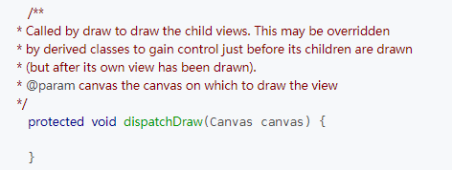
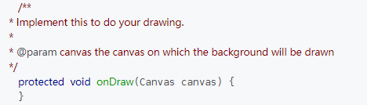
Draw
BackGround
onDraw
Dispatch
Draw
View
繪製流程
onDraw(): draw View’s Content
dispatchDraw(): draw children
Let’s think about it. What are there inside these 2 methods of a View?
Measure
Layout
!!!!
Draw
They are both Empty​
Because the native View class does not have any content and it does not have any child neither.
End
Notes:
我們先猜一下View 裡面的onDraw 跟 DispatchDraw會有什麼內容。
他們都是空的!
View是基本的顯示內容，因為沒有content.. 沒有需要顯示的內容所以是空方法\
而且他沒有Child，所以這邊會是空的
ViewGroup是有

Slide 36
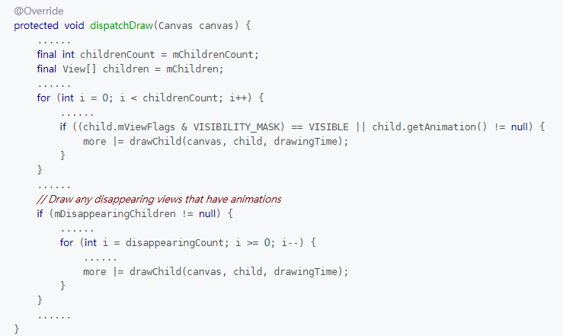
Draw
BackGround
onDraw
Dispatch
Draw
View
繪製流程
dispatchDraw() in ViewGroup:
Iterate over all children and call ondraw() of every child.
Measure
What we need to do is to override ondraw()!
Layout
Draw
End

Slide 37
Recap: Stack call and FlowChart of Draw
Perform
Traversal()
View
Group
draw
ondraw
dispatch
Draw
Measure()
HasNext
Child View?
End
getMeasured
Width/Height()
NextView:
View or ViewGroup?
Layout()
onDraw
draw
View
View
Draw()
ViewGroup

Slide 38
Now, we know the entire drawing procedure of View and ViewGroup
View
繪製流程
Measure: Given Layout parameters and parent MesureSpec, measure height and width of a View
Layout: Given measured height and width of itself and children, put children in a customized way by setting its (r,l,b,t).
Draw: Given a rectangular area bounded by (r,l,b,t), draw view’s content
Measure
Layout
Draw
End

Slide 39
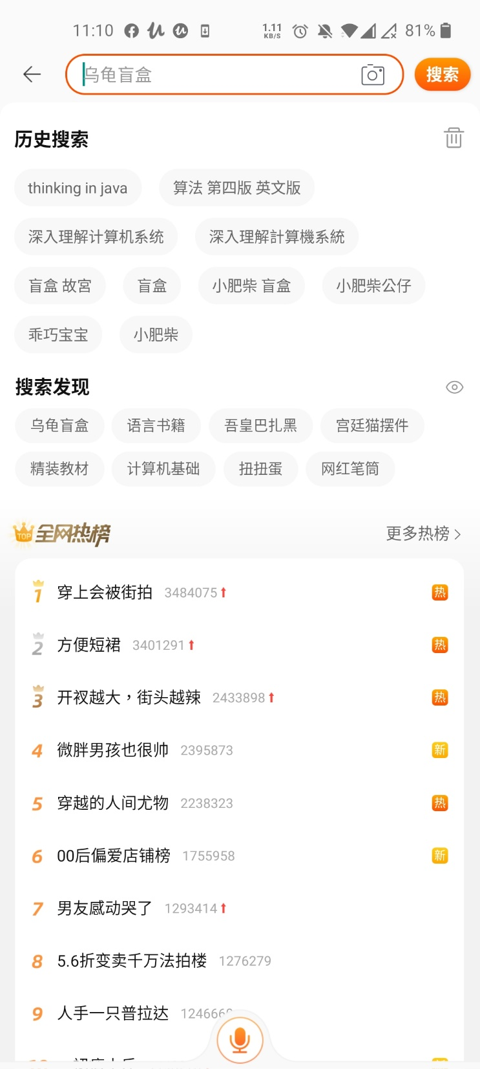
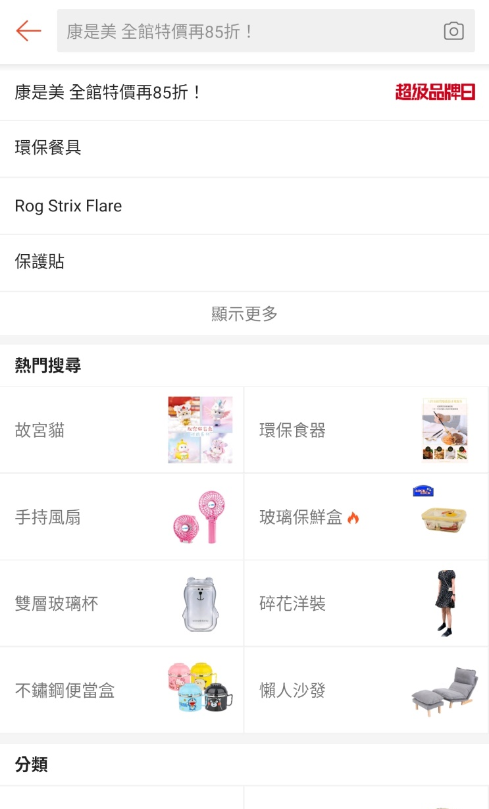
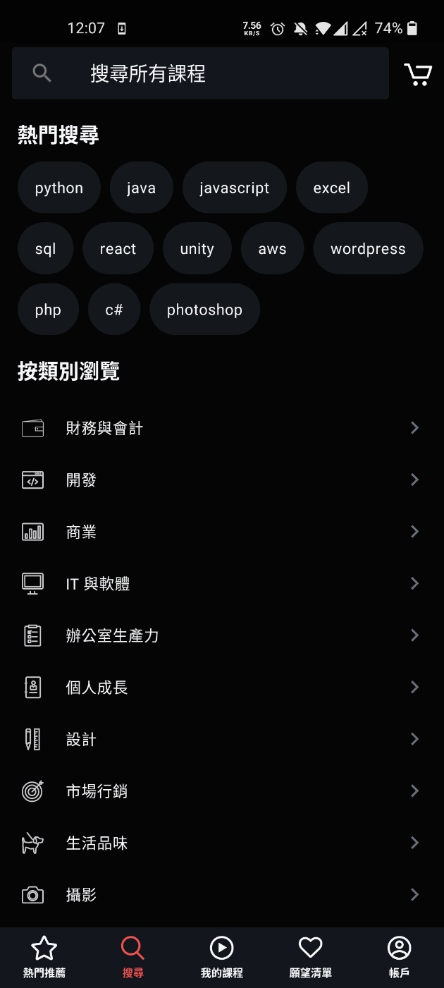
Example of Custom ViewGroup: FlowLayout

Slide 40
Implementing Procedure
開始
1. Set up Adapter
2. Pass Data set or Create inside the class
3.Wrap Data set in .XML
Extends
ViewGroup
Define/Retrieve
Attributes
The Key Point of Laying Children: Dynamically Compute Coordinates and Height and Width. It is prone to make bugs.
Add Child Views
Measure
Self/
Children
LayChildren
Define Interface
Handle TouchEvent

Slide 41
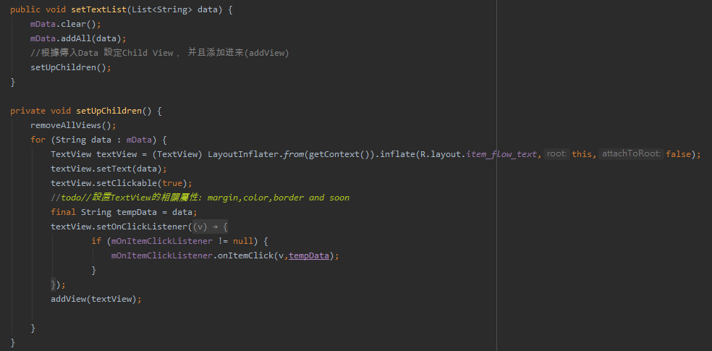
Add Child Views:

Slide 42
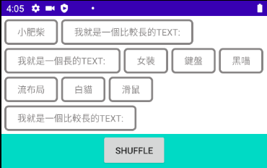
Measure self:
依次測量Child List裡面每一個Child。
設定一個 2 dimensional list, 用來存放每一個Row可以存放的Child Views:
計算Child View和間距的累加寬度。判斷當前Child 是否可以被加入當前Row，如果超出Parent View寬度，就把他放入下一個Row
動態的增加Row的數量直到所有Child View 都被加入到這個2D List
最後根據Row的數量 設定Parent ViewGroup自己的Height 跟Width

Slide 43
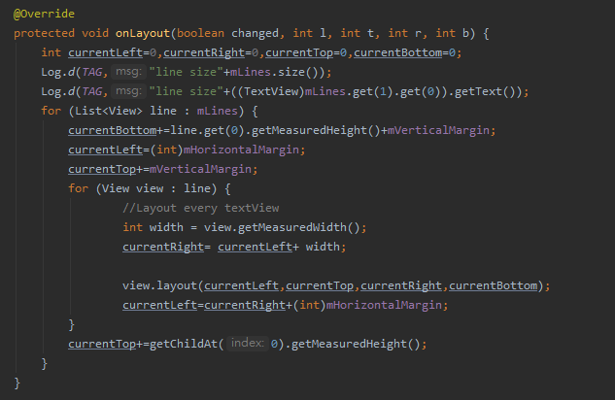
Lay Children
根據剛剛的2D List取出Child View
根據Column和Row的間距以及Child View的寬度和高度計算它們應該擺放位置的座標(l,t,r,b)。 以此來擺放 每一個Child View

Slide 44
Custom View: onDraw()
Canvas(畫布):
Canvas裡面有一個member Variable是Bitmap, 我們畫的 東西都是畫在這個Bitmap上面，而Canvas本身提供了一些畫什麼內容(Shape)的method:
drawColor, drawCircle(), drawLine(), drawText(), drawRect()….
這些Method通常要傳入你要畫得起始座標(X,Y)以及圖形大小本身的參數(Length Radius等)，最後要傳入畫這個圖形的Paint
Paint(塗料，畫筆):
設定畫筆的參數可以控制會畫圖形的風格(填滿或線條)，圖形的顏色，線條的粗細，是否反鋸齒anti-aliasing

Slide 45
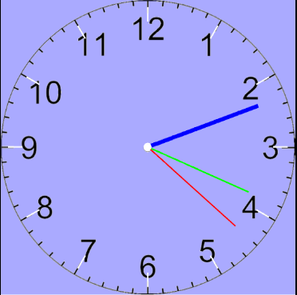
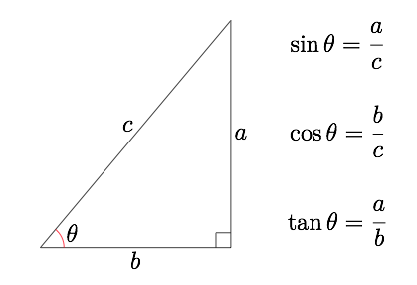
Example of Custom View: WatchFace
Step 1 : 畫背景 (drawColor)
Step 2 : 畫錶盤上的刻度 :
(通過三角函數取得XY座標)
(旋轉Canvas)
Step 3 : 取得目前時間，根據目前時間畫時針分針秒針
Step 4: 通過Handler 每1秒執行一次Invalidate，更新錶盤

Slide 46
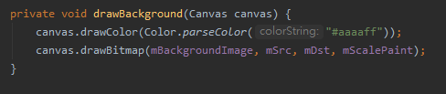
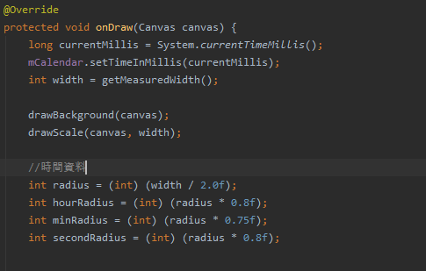
Step 1:畫背景

Slide 47
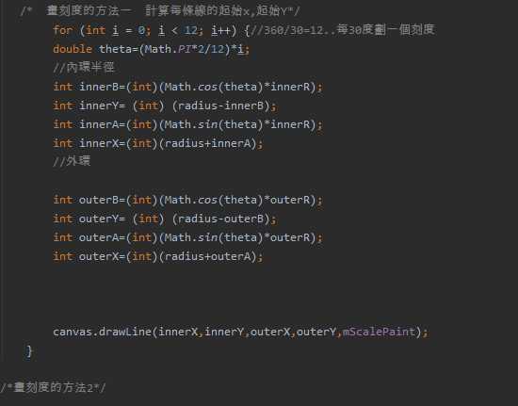
Step 2 :畫刻度(通過三角函數取得XY座標)
X
a
Θ
b
Y

Slide 48
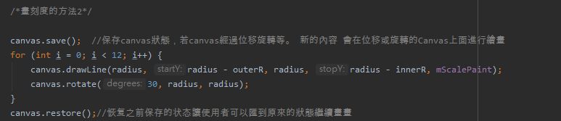
Step2 :第二種畫刻度的方法
Canvas may have different status(Coordinate System) after the following operation:
canvas.rotate() canvas.translate() canvas.restore()
Canvas.save(); push current status of canvas into the stack
Canvas.restore(); pop the of stack and restore the canvas’ status

Slide 49
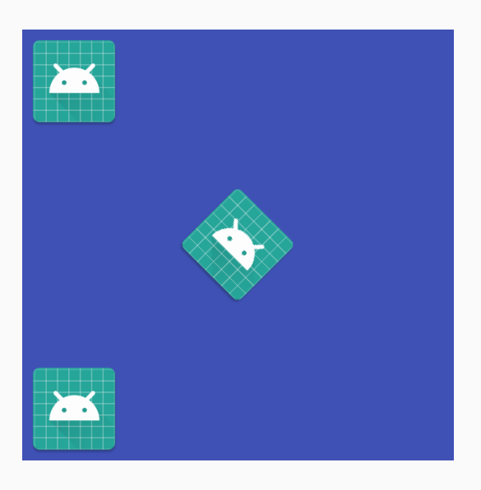
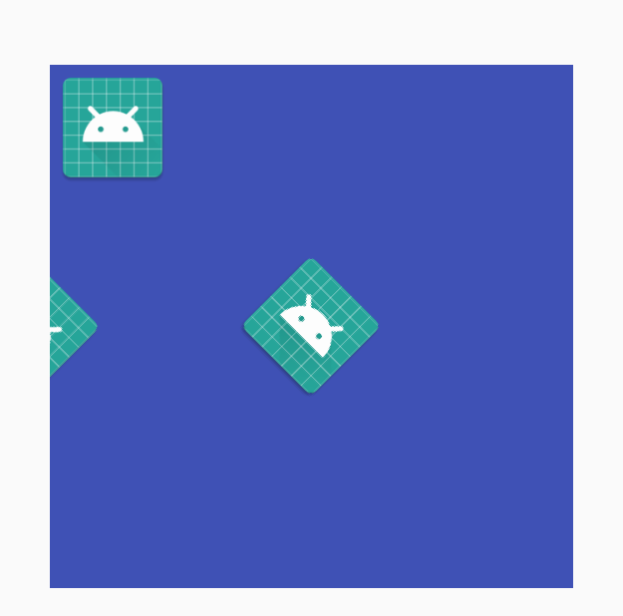
Canvas: save(), rotate(), restore()
修正後:
Canvas.drawBitmap(0,0,bitmap,null);
Canvas.save();
Canvas.rotate(45);
canvas.drawBitmap(bitmap, 50, 50 , paint);
Canvas.restore();
Canvas.drawBitmap(bitmap, 0 , 100, paint);
預期:
Canvas.drawBitmap(0,0,bitmap,null);
Canvas.rotate(45);
canvas.drawBitmap(bitmap, 50, 50 , paint);
Canvas.drawBitmap(bitmap, 0 , 100, paint);
實際結果:
X

Slide 50
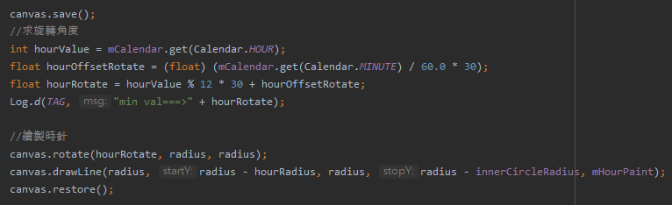
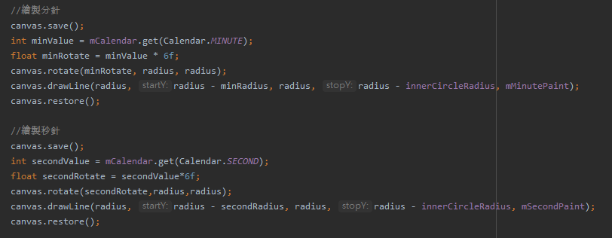
Step 3:畫3種時間

Slide 51
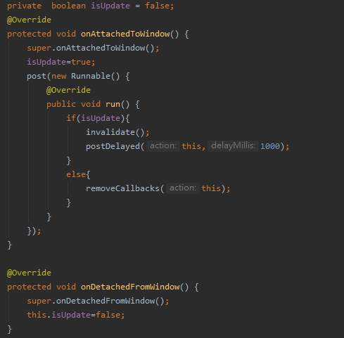
Step 4: update watch face

Slide 52

Analysis of SeekBar
Center Coordinate of Thumbnail
Boundary Coordinate of Thumbnail
Thumbnail’s color or Size
Progress
Background Line and Progress Line
Data List
Thumbnail Text Format
Override onTouchEvent() based on above variables
Gap between the Line and View Boundary
The seekbar could be implemented either by Compound Components or Custom View.
Notes:
组合的重点在于 update layout parameters. Custom View的重点在于计算Coordiante 然后Call invalidate重新draw一次

Slide 53

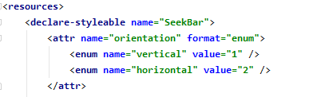
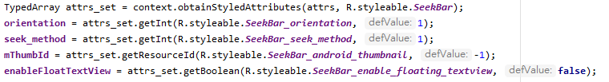



Example of Compound Components: SeekBar
Start
Layout
Extends
a layout , ex: LinearLayout, RelativeLayout
Define/ Retrieve Attributes
Inflate Compound
Views
Initialize UI and Data based on
Attributes
Define Interface,
Expose Interface Method
Handle TouchEvent

Slide 54
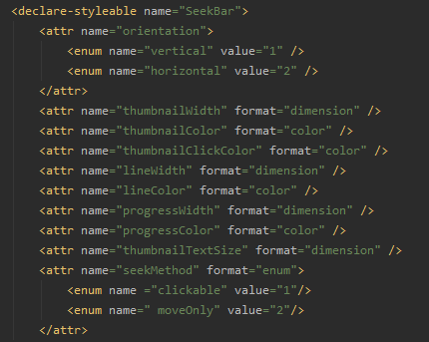

Example of Custom View: SeekBar
InitializeAttributes:

Slide 55

Example of Custom View: SeekBar
Initialize:

Slide 56


Example of Custom View: SeekBar
onMeasure():

Slide 57


Example of Custom View: SeekBar
onDraw()

Slide 58


drawText

Slide 59

Draw Text in the center of Rectangular

Slide 60
大長圖 載入
問題描述:
有一張很大的長圖片. 他的寬度和高度都大於手機螢幕
因為是長圖，我們希望將圖片縮小，使得寬度和手機寬度一樣
因為圖片很大，即使寬度縮小，依然無法一次性載入，我們需要每次只載入部分圖片

Slide 61
大圖 載入 問題分析
OOM will occur:
1 pixel of RGB occupies at least 2-3bytes (565, 888) in memory
Ex : 1920x1080 =4MB 800*10000=24MB
Partially decoding and loading (Rect, RegionDecoder)
Thrashing will Occur
Memory reusing (Bitmap.Options)
Override onFling() onScroll()

Slide 62
超大長圖 載入
Same as previous:
Partially decoding and loading (Rect, RegionDecoder)
Memory reusing (Bitmap.Options)
Scroll event

